Slide 1
Leaf nitrogen responses to soil nitrogen

Slide 2
Rationale
Leaf N_{area} is an important variable for ecosystem carbon and N fluxes
Used to predict photosynthesis in ESMs, including downregulation from N limitation
Not clear how or why leaf N_{area} responds to soil N availability

Slide 3
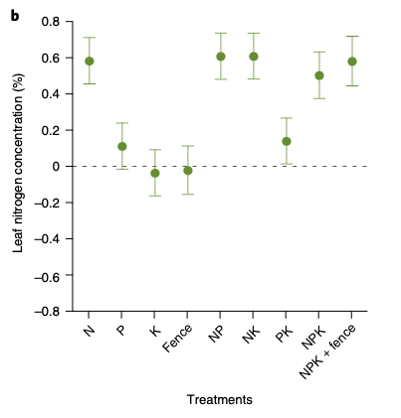
Rationale CTD
Firn et al. (2019): strong link b/w soil N and leaf N%

Slide 4
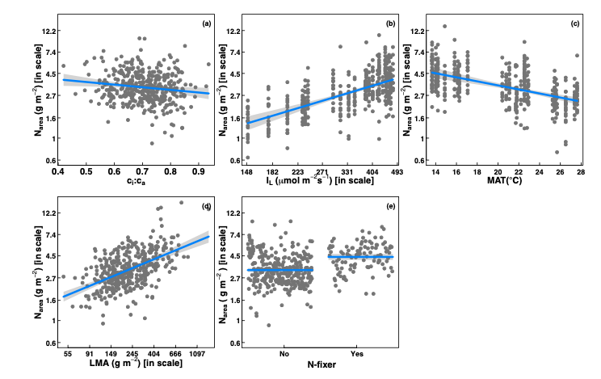
Rationale CTD
Dong et al. (2017): it’s mainly climate and adaptation (LMA, Nfixer)

Slide 5
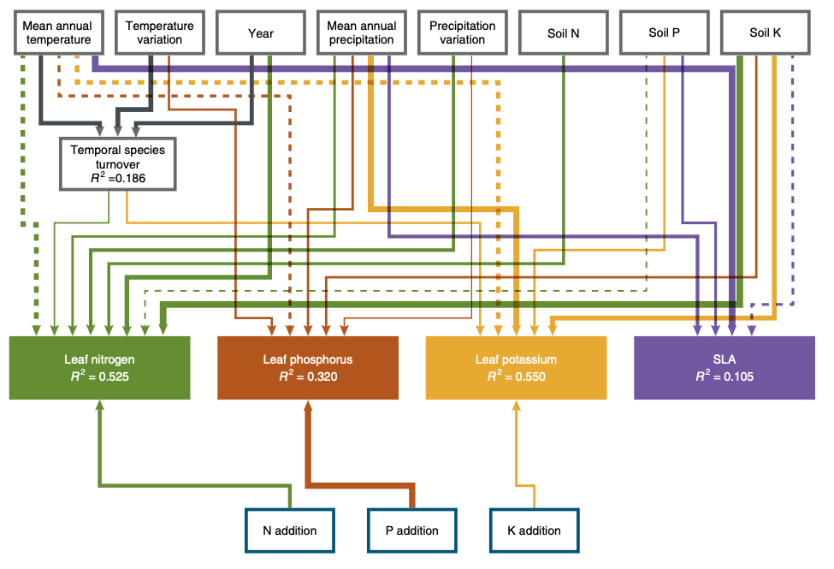
Rationale CTD
Firn et al. (2019) kinda showed that too!

Slide 6
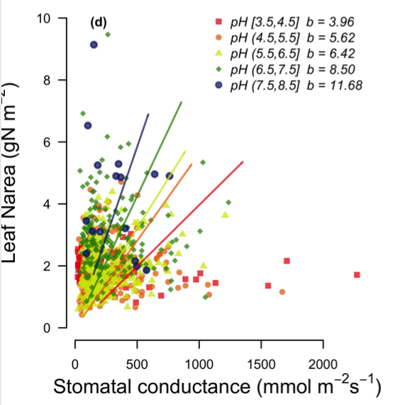
Rationale CTD
Recent analyses suggest that soil N may modify the nutrient economy of leaves (Paillassa et al., 2020)

Slide 7
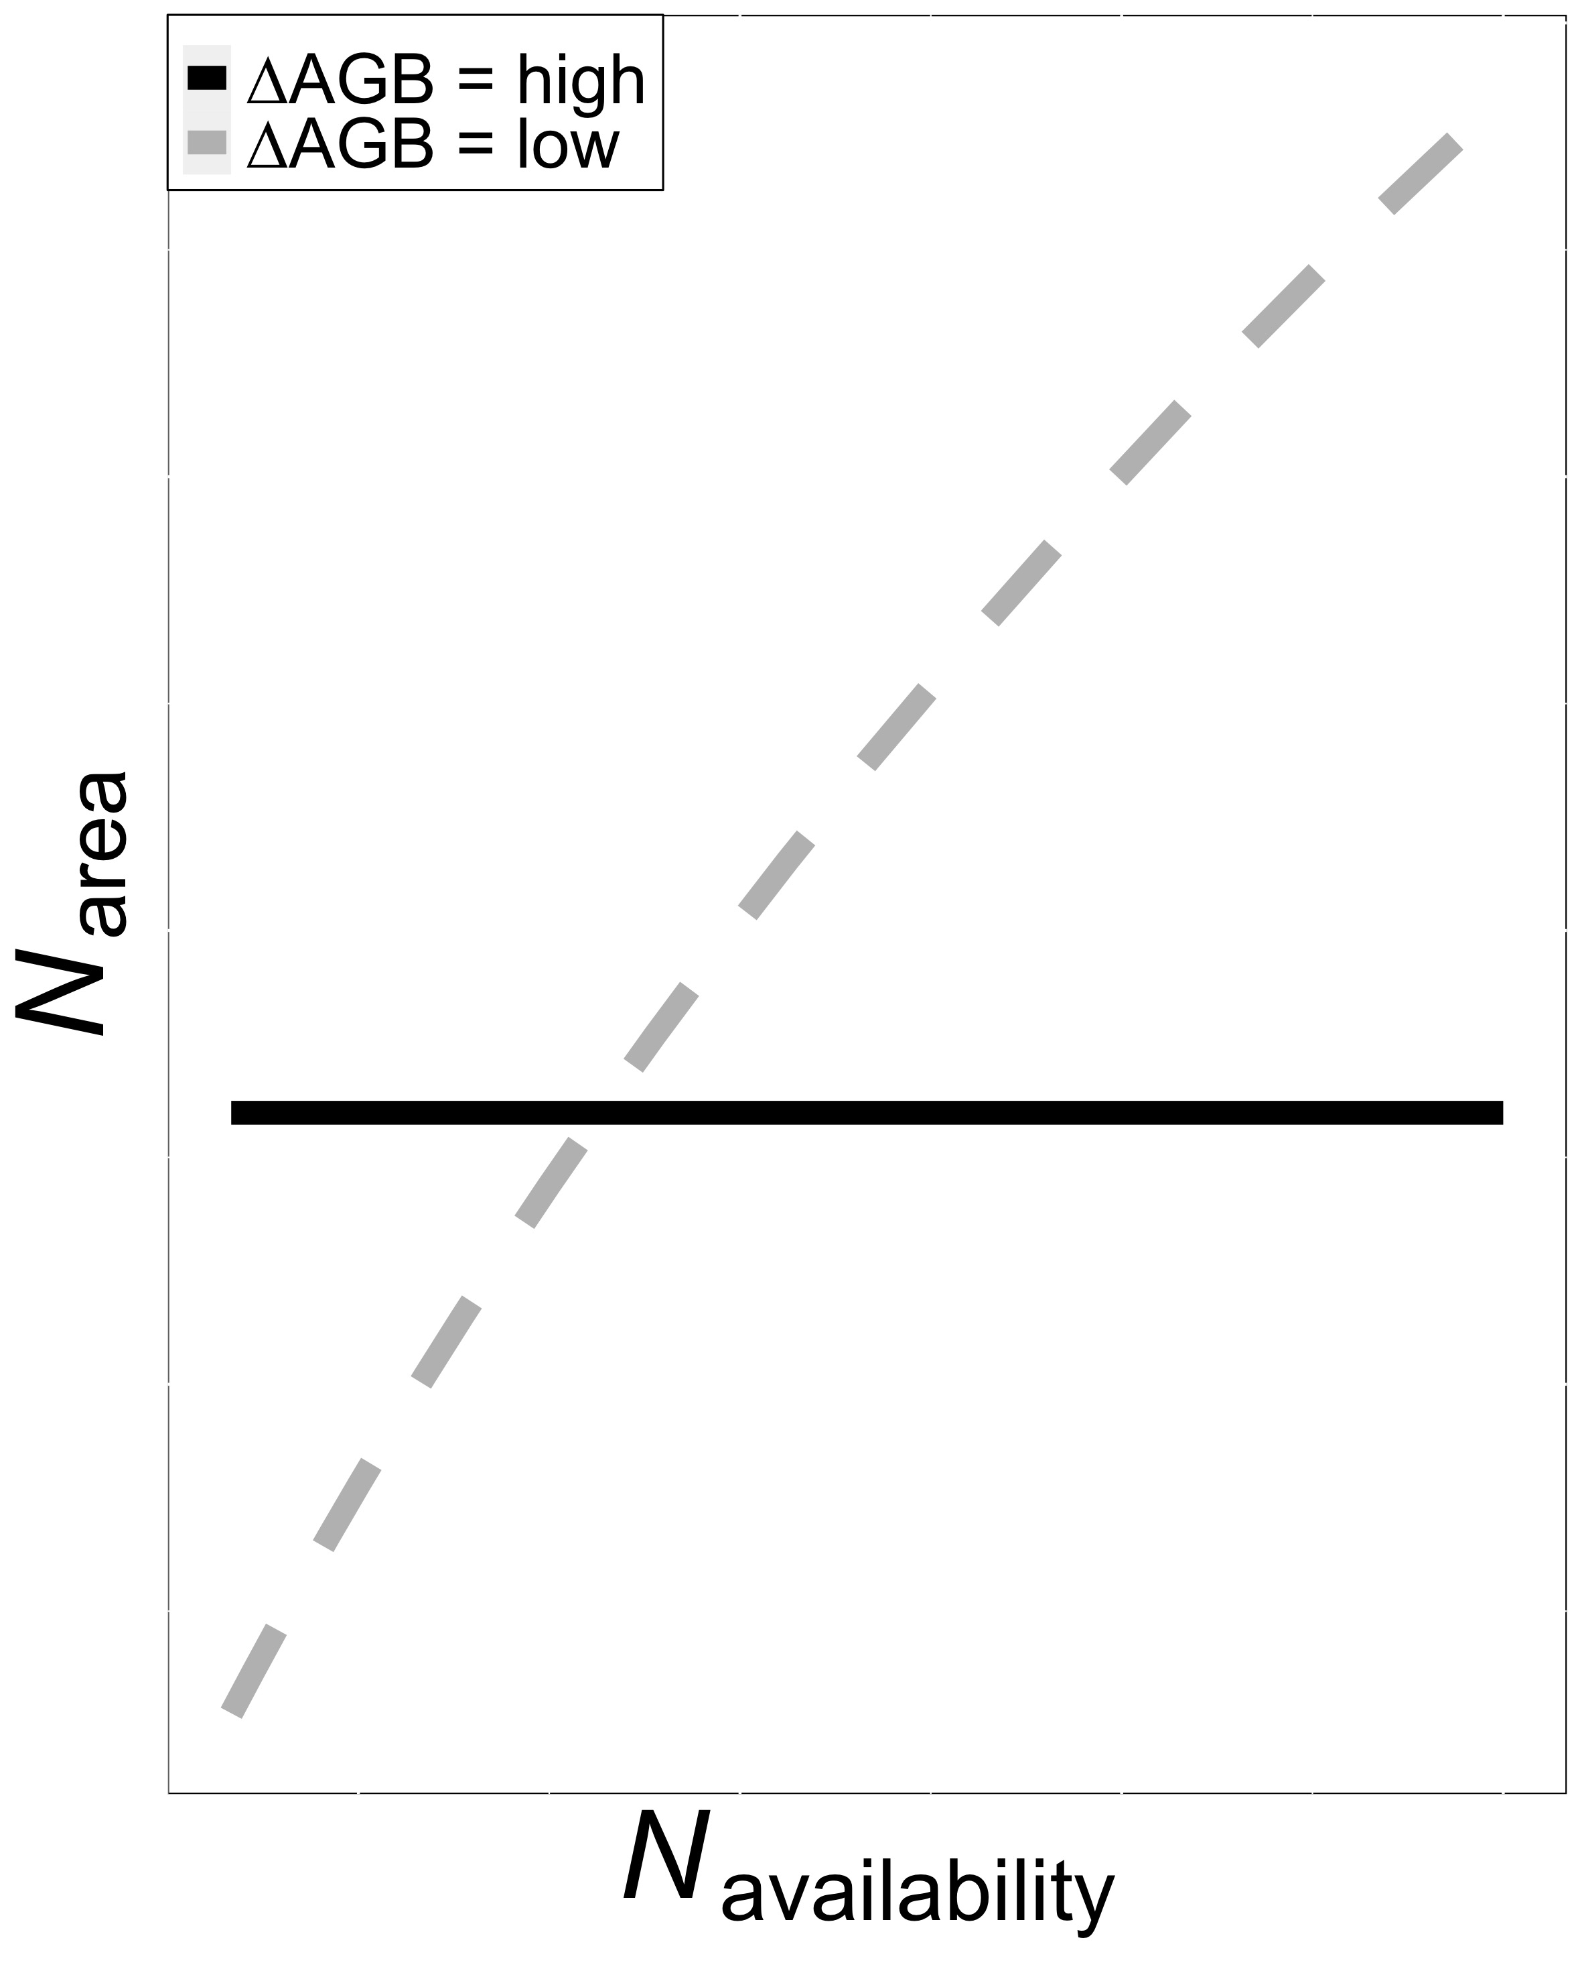
Rationale CTD
Recent analyses suggest that soil N may modify the nutrient economy of leaves (Paillassa et al., 2020)
This may depend on allocation responses

Slide 8
Specific aims
Quantify and separate the impact of soil nitrogen, leaf traits, and climate on N_{area}
Assess the predictability of N_{area} from theory using aboveground climate and leaf traits alone
Quantify the impacts of soil nitrogen availability on aboveground biomass
Assess tradeoffs between biomass production and allocation to N_{area} under different soil nitrogen conditions

Slide 9
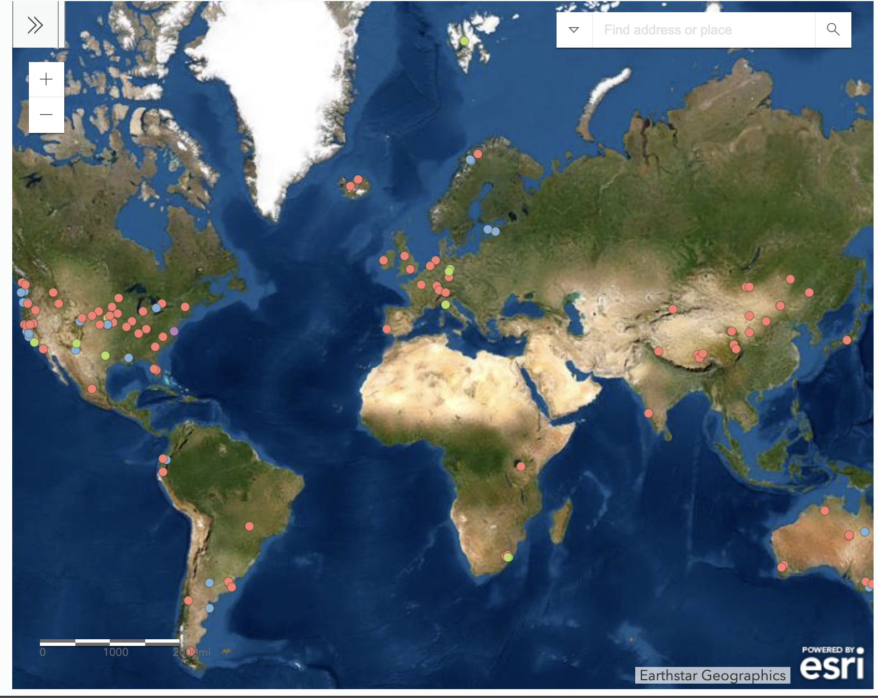
Nutrient Network (NutNet)
Globally distributed soil nutrient manipulation experiment
Fully factorial soil N x P x K addition experiment (10 g m-2 yr-1)
At least 3 blocks per site

Slide 10
Datasets
NutNet leaf trait data
n = 2048, 195 species, 22 sites
N_{area}
LMA
d13C (converted to χ)
Growing season climate conditions (CRU)
NutNet plot data
Site years from leaf trait dataset only
n = 487, 15 sites
AGB

Slide 11
Analyses
**Analyses generally follow Dong et al. (2017)**
Drivers of leaf N_{area} (mixed model)
Dependent variable: leaf N_{area}
Fixed effects: soil N * soil P * soil K + χ + temperature + PAR + LMA +Nfixer + photosynthetic pathway
Random terms: species + species:site + species:site:block

Slide 12
Analyses
**Analyses generally follow Dong et al. (2017)**
Predictability of leaf N_{area} (mixed model)
Dependent variable: leaf N_{area}
Fixed effects: soil N * soil P * soil K + predicted Nphoto + predicted Nstructure + Nfixer + photosynthetic pathway
Random terms: species + species:site + species:site:block

Slide 13
Analyses CTD
AGB response to soil N
Dependent variable: plot AGB
Fixed effects: soil N * soil P * soil K
Random terms: site + site:block
Allocationeffects on leaf N_{area} (linear model)
Dependent variable: change in plot averaged leaf N_{area} in N addition plots
Fixed effects: change in plot AGB, LMA, and χ in N addition plots

Slide 14
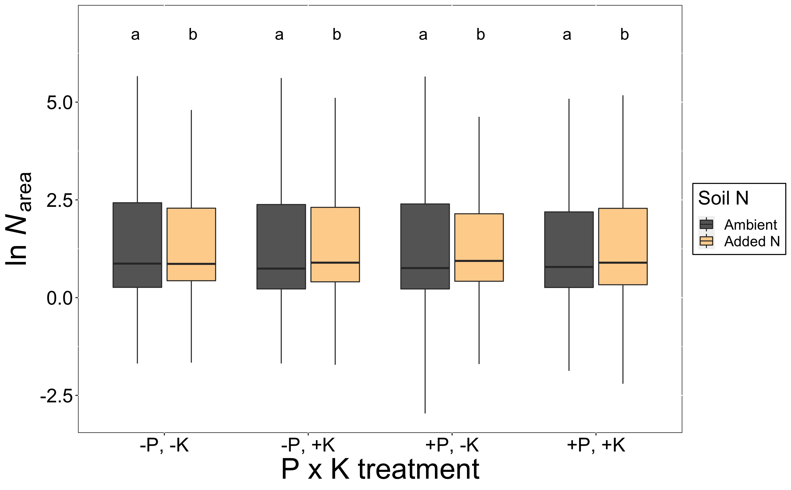
Results: Does soil N impact leaf N_{area}?
13% increase in leaf Narea with soil N (p < 0.01)

Slide 15
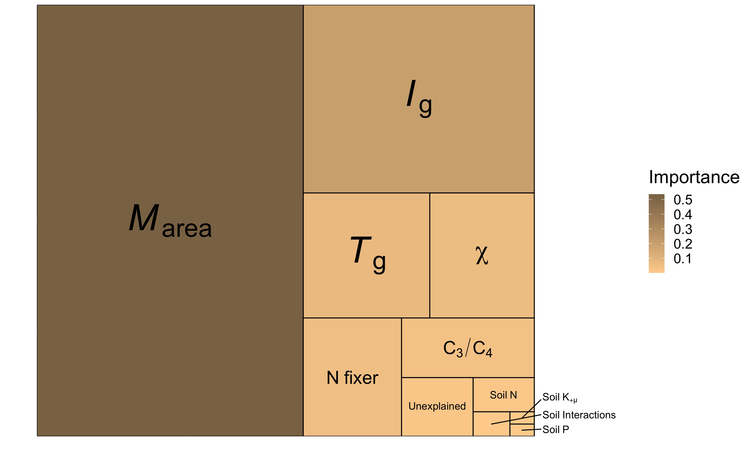
Results: What about other variables?
Soil is not that important (<2% combined)

Slide 16
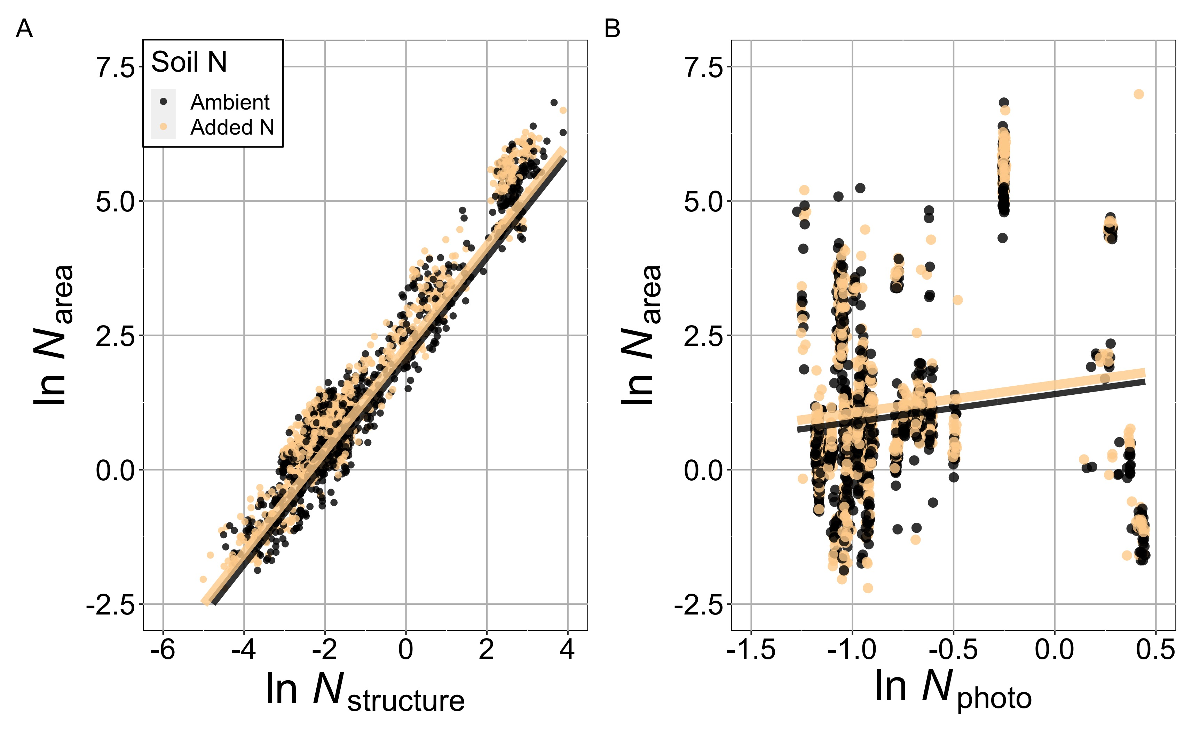
Results: Can we predict N_{area}?
Soil N (P < 0.01)
N_{structure} (P < 0.01)
N_{photo} (P < 0.01)

Slide 17
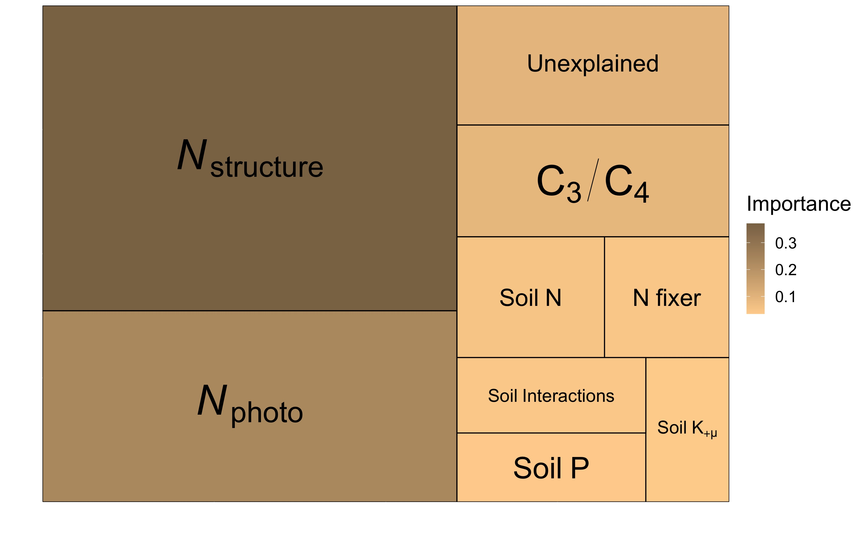
Results: Can we predict N_{area}?
Structural and photosynthetic N combined explain 61% of the variation in leaf N_{area}

Slide 18
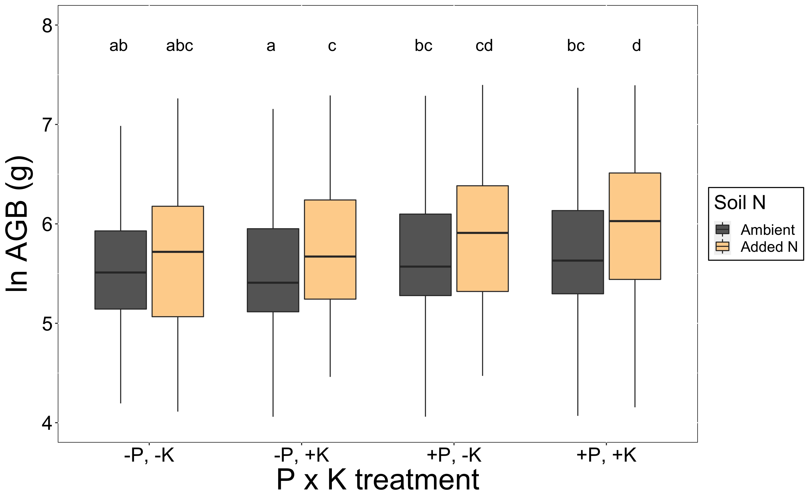
Results: What is the AGB response to soil N?
4% increase in AGB (P < 0.01)
Only significant in +K treatment

Slide 19
Results: Does the impact of soil N on leaf N_{area} vary with the change in AGB?
The change in leaf N_{area} should be greater in places where the AGB doesn’t change much

Slide 20
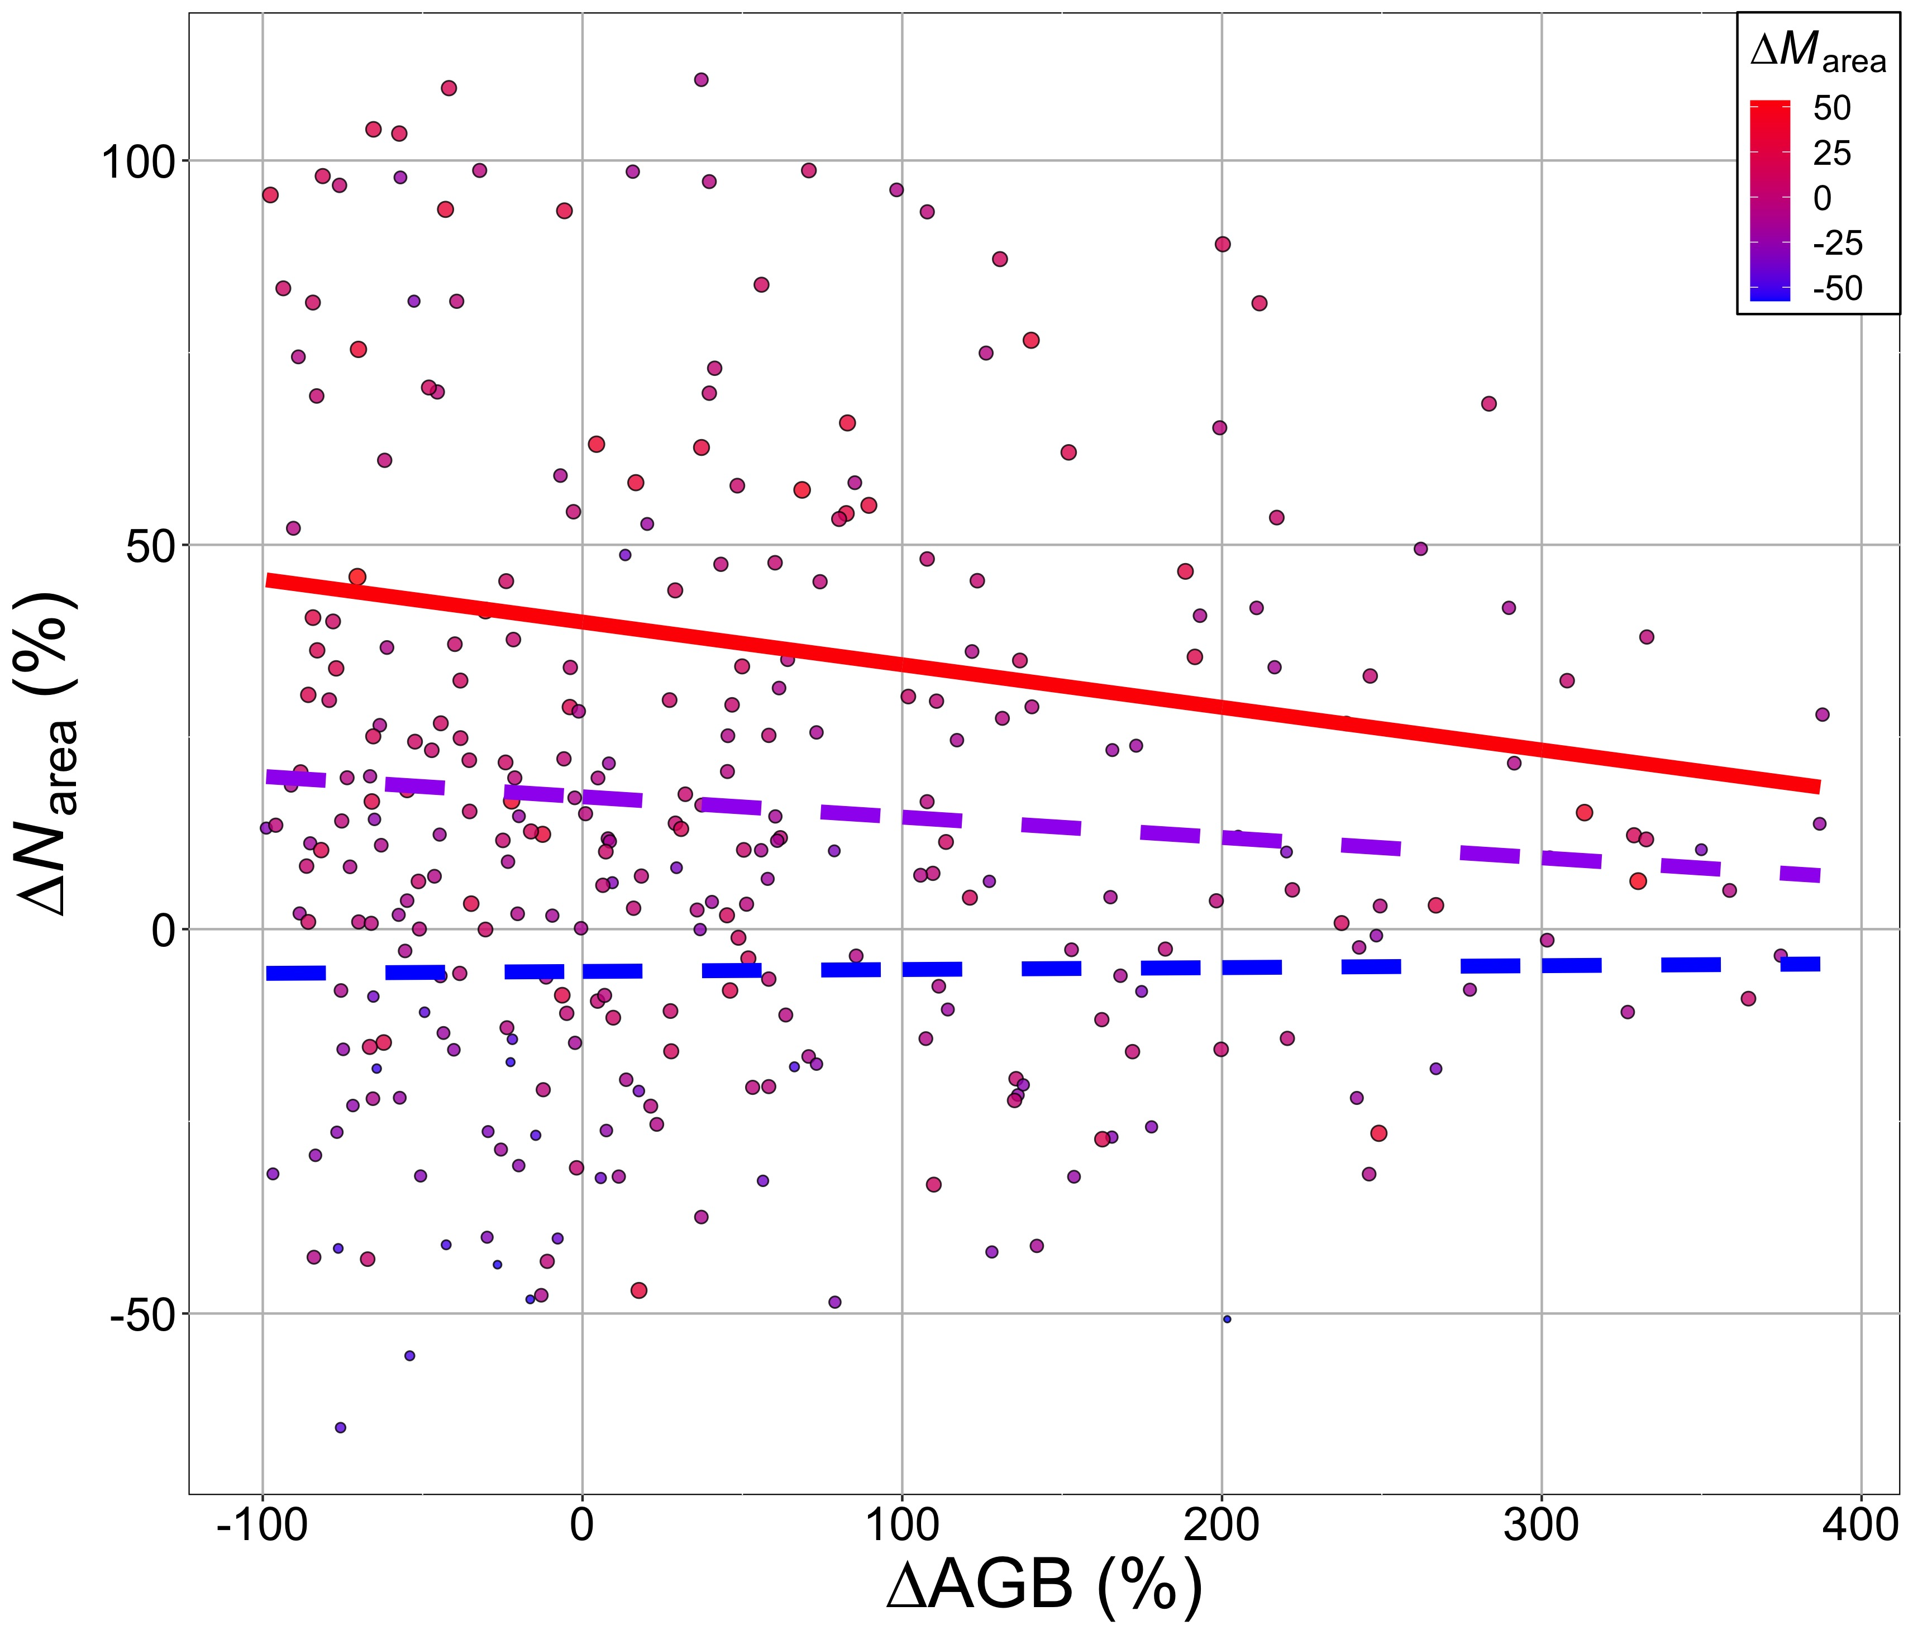
Results: Does the impact of soil N on leaf N_{area} vary with the change in AGB?
When LMA increases with soil N and biomass shows a limited response to soil N, N_{area} increases with soil N
Red = high positive LMA response to soil N
Blue/purple = limited to no LMA to soil N

Slide 21
Take homes
Soil nitrogen increases both N_{area} and AGB
Climate and leaf traits are better predictors of N_{area} than soil nitrogen addition
Positive relationship between soil N and leaf Narea is greatest when LMA change is high and biomass change is low

